Slide 1

Principal Conference Activities
201857尹达恒
2020/9/27
Notes:
Hello everyone, today I’ll introduce the activities in principal conference

Slide 2
Index
Formal Meetings
Informal Meetings
Audio & Visual Presentations
Teaching & Consulting Services
Exhibitions & Business Talks
Visits & Other Social Activities
Notes:
The introduction has 6 parts,
（念一遍）

Slide 3
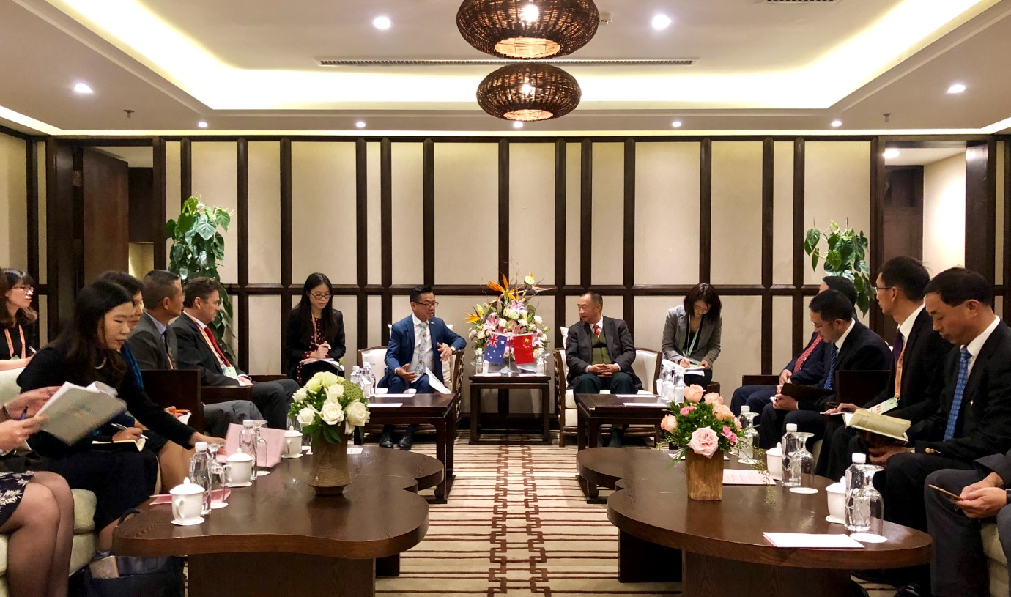
Formal Meetings
Notes:
At first, let’s talk about formal meetings.

Slide 4
General Assembly
Attendees:
all participants of the conference
government officials and reporters
Activities:
Opening ceremony
Welcome speeches by governmental officials and organizers
General speeches by distinguished guests and outstanding experts
Closing ceremony
Notes:
In most cases, General Assembly is the first part of the Principal Conference.
It usually attended by not only the participants of the conference but also government officials and reporters sometimes.
The major activities in General Assembly are welcome speeches by governmental officials and organizers and general speeches by some distinguished guests and outstanding experts

Slide 5
Plenary Sessions
Attendees:
all participants of the conference
Activities:
Invited lectures and keynote presentations
about research subjects of universal significance and general interests
by well-known experts in particular field
Questions and discussions
Notes:
After General Assembly, there usually the Plenary Sessions.
Its attendees are all participants of the conference, but compared to General Assembly, the Plenary Sessions are much more professional.
In Plenary Sessions, the major activities are invited lectures and keynote presentations by well-known experts in particular field
This lectures are about research subjects of universal significance and general interests in this fields

Slide 6
Parallel Sessions
Attendees:
Research groups in particular field
Activities:
Presentations about individual papers about a special topic
Topic discussion
Notes:
After Plenary Sessions, there will be many Parallel Sessions held simultaneously.
This Parallel Sessions are small-scale conference about a particular field.
Its attendees are the research groups in these particular field.
In Parallel Sessions, presentations and discussions are usually limited in particular topic, and is often about individual papers from particular research groups.

Slide 7
Poster Sessions
Attendees:
Anyone of the conference
Activities:
Author post the paper on board or wall and waiting aside
Participants read the interested paper
Participants discuss with the author
Participants leave messages to the author (if author is not on site)
Notes:
In the meantime, there are also many Poster Sessions.
In the Poster Sessions, there are many authors post their papers in particular area, the participants will walk around and read the papers they’re interested in, and discuss the paper with the author waiting aside, or leave the message if the author is not aside.

Slide 8

Informal Meetings
Notes:
Then, let me introduce informal meetings.

Slide 9
Informal Meetings
Free Information Exchange
Exchange and discuss ideas
Talk about interested subjects
Free Paper Presentation
Oral introduction about the paper
For those delayed paper or paper not presented in regular sessions
“Free Communication” Sessions
Means interactions during the break of the conference

Slide 10
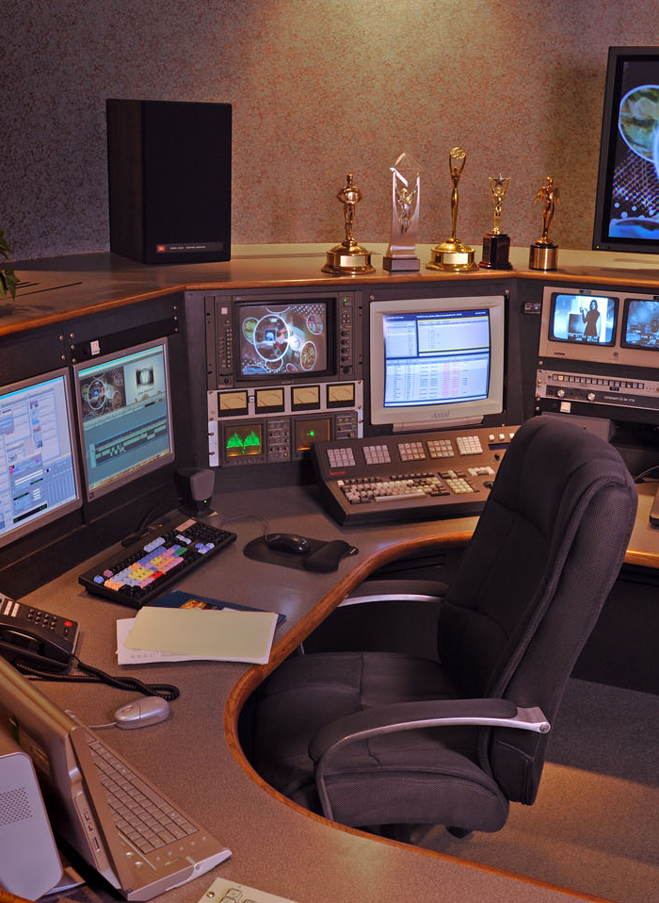
Audio & Visual Presentations
Notes:
In modern world, the audio and visual presentations are wide-spread in academic conferences.

Slide 11
Audio & Visual Presentations
Overhead projectors
Slide projectors
Videotapes
Short film projectors
Poster demonstrations
PowerPoints
……
Notes:
Including（念一遍）

Slide 12
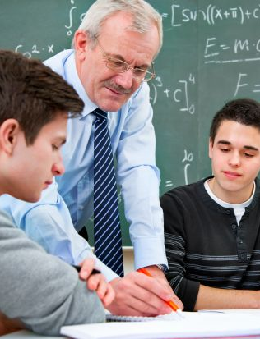
Teaching & Consulting Services
Notes:
In many international conferences, there are also some teaching can consulting services.

Slide 13
Teaching Services
Attendees:
Young students
Activities:
Classes to access required knowledge
Forms:
Educational courses
Pre-conference institutes
Teaching day for tutoring
Tutorial workshop
……
Notes:
The teaching services is organized for young students, to access required knowledge and make them familiar with the subjects of the forthcoming meeting.
Form of classes is various, include（念一遍）and so on.

Slide 14
Consulting Services
Attendees:
Experts with both theoretical and practical experience
Participants concerning about application of technology
Activities:
Provide consults about certain practical performances
Notes:
Besides teaching services, there are also consulting services.
It’s offered by experts with both rich theoretical and practical experience.
And the participants are those who concerning about application of technology.
The expert will provide consults about certain practical performance .

Slide 15
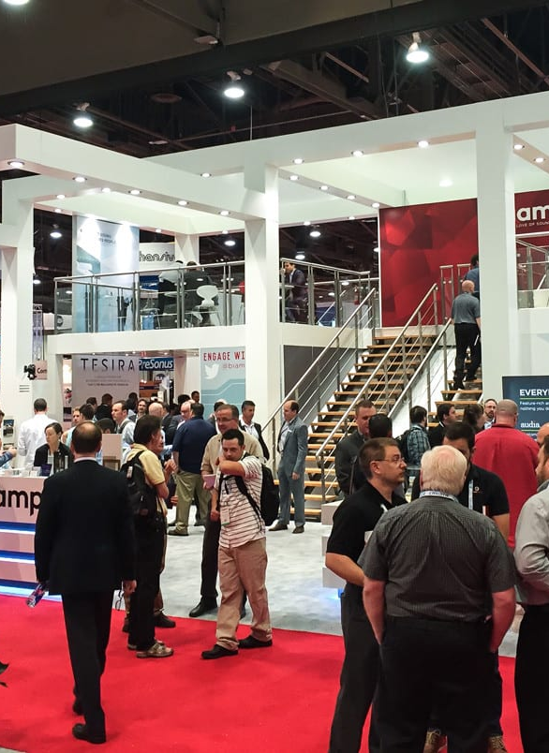
Exhibitions & Business Talks
Notes:
In many international conferences, there are also some Exhibitions & Business Talks

Slide 16
Scientific Exhibition
Achieve better effect of communication between academic and technology
Display the results of scientific research
New equipments
Crafts
Products
Books & journals
……
Notes:
Scientific Exhibition is established to achieve better effect of communication between academic and technology.
It include （念一遍）

Slide 17
Conference & Trade Exhibition
Conference Exhibition
Trade Exhibition
Display the achievements of applied technology
The exhibits are displayed, introduced and prepared for sale
Notes:
Then there are two exhibitions that both display practical achievements.
One is Conference Exhibition, established to show new achievements of applied technology,
The other is Trade Exhibition, in trade, the exhibits are the products for sale,
They will be displayed, introduced and prepared for sale.

Slide 18
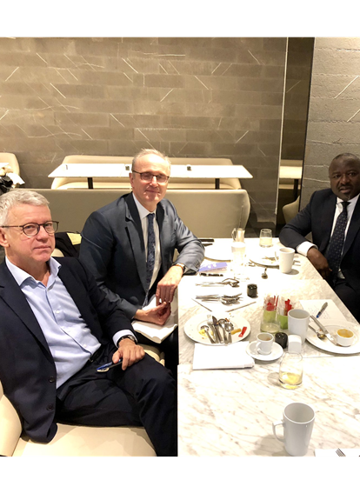
Visits & Other Social Activities
Notes:
At last

Slide 19
Visits & Other Social Activities
Visits to related places:
Famous research institutes
Universities & colleges
Museums
Manufacturing or mining enterprises
Historical or scenic spots
Social events
Parties, games, concerts
For extensive contact and friendship establishment
Notes:
Besides meetings and exhibitions, their also many other activities in Principal Conference.
Sometimes there will be visits activities during the break of the conference.
Visit destinations include（念一遍）and so on.
Also, there will be some social activities such as parties, game and concerts.
For extensive contact and friendship establishment.

Slide 20

Thanks for listening

